Slide 1

Introduction to Social Media
Notes:
Social networking is the latest internet phenomenon to become part of our lives. In this session we are going to talk about what social media is and how it can assist you with your career exploration and job search. We’ll discuss tips on how to develop a personal profile. We’ll share some do’s and don’ts when using social media.

Slide 2
What is Networking ?
“Practice of gathering contacts.”
“The process or practice of building up or maintaining informal relationships, especially with people whose friendship could bring advantages such as a job or business opportunity. “
Notes:
Have you heard of networking when you are looking for a job? Talking to people, making contacts, etc.. .. It is often “who you know” that helps get the job.

Slide 3
What is social media networking?
Websites that:
Allow users to find people with common interests
Share resources, ideas, and events
Connect with professionals
Notes:
Okay, so what is social networking? What’s it all about? Like this, follow who?, tweeting… Social media is the same as networking; its just done electronically. Its networking that is internet based. Its using technology to communicate and open up dialogues with others.

Slide 4
Name
That
Icon
Notes:
Just for fun, we’re going to do an exercise. I am going to pass out a paper showing different social media icons. You are to try to identity the name of the social media that corresponds to the icons in 5 minutes.
Facilitator: Pass out the Social Media Icons quiz and allow sufficient time for participants to complete.

Slide 5
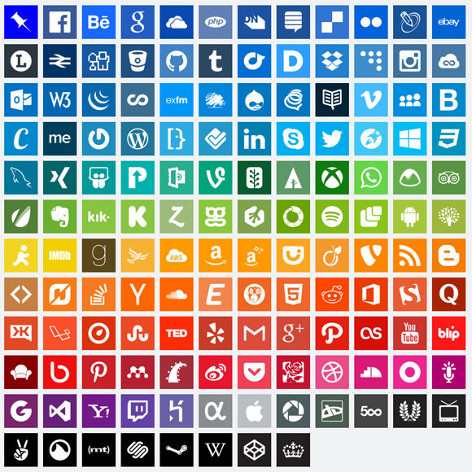
Notes:
Facilitator: Pass out the Social Media Icons Answers sheet.
There are hundreds of active social networking sites. The answer sheet for our icon exercise gives an idea as to what just a very few of them are. Each one has its own purpose and personality.

Slide 6
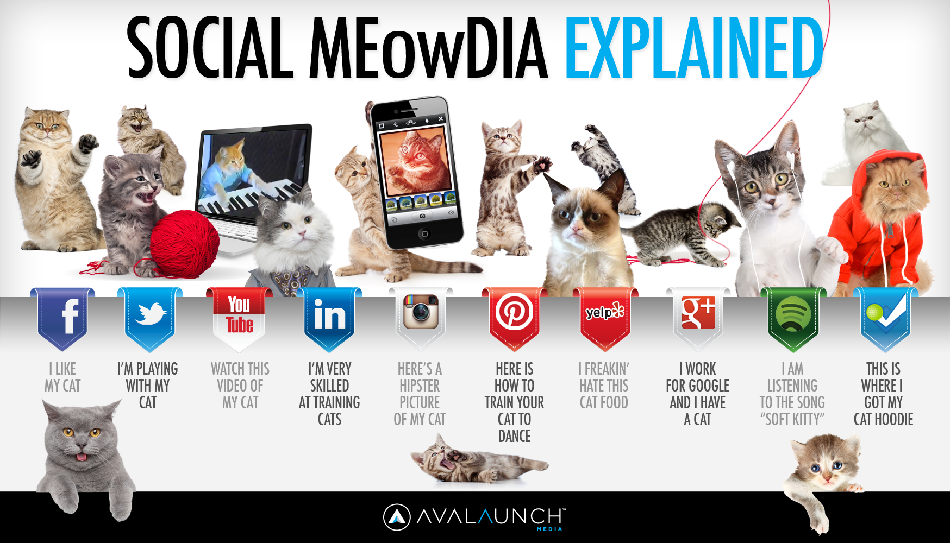
Notes:
One way to explain social media is with cats!! Facebook-share information with friends, Twitter-brief statements telling what you’re doing, YouTube-video sharing website, LinkedIn-professional information sharing, Instagram-photo sharing website, Pinterest-”how to” information, Yelp-reviews and ratings, Google+- members only, spotify-music videos , and foursquare-where to go to find things.

Slide 7
How do employers use social media?
Social proof
Fast/cheap background checks
Tracking systems
Notes:
Job search strategies began to change in the mid 1990’s. Employers have turned to technology to help them manage their recruitment efforts. The appearance of search engines and social media have made job hunting more challenging for many people.
Social proof - Employers compare resumes and applications with what is shown on an applicant’s social media profile. Are the jobs, education, skills etc the same?
Background check - A recent study showed that 80% of employers also use social media to discover more about an applicant’s personality, background, interests, etc.
Tracking - The use of Applicant Tracking Systems (ATS) makes the use of keywords even more important on our on-line resumes.

Slide 8

There are benefits!
Able to reach a wide network of people
Most sites are FREE
Opportunity to showcase talents
Connect with people of similar interests
Access from anywhere with internet: computer, smart phone, or tablet
Can access 24 hours a day/365 days a year
Notes:
The benefits of using social media for job seekers are almost too many to mention !

Slide 9
and more benefits !
Market and promote your skills
Gain access to top experts
Unique company research
Online Rolodex
Find professional peers
Locate job postings

Slide 10

But what’s the catch?
Digital Divide
Learning curve (generational differences)
Upkeep - maintaining profile
You don’t know who is viewing your profile
Privacy issues
  What can people see?
  How can I protect myself online?
Notes:
Some people just can’t afford a computer, smartphone, an ISP.
Learning curve – it may be the older generations don’t know how to use a computer, or they may just not want to change the way they’ve been doing things.
3 It’s time consuming to keep everything up to date.
Most sites, you don’t know who is viewing your profile.
Let’s talk privacy!

Slide 11
You have a reputation to protect!
Google yourself
  Set up Google alerts
Check privacy settings
  Ask someone for help
  Each site has them
  No unprofessional information
Have separate accounts
  One personal; one professional
Notes:
Google yourself. What comes up? Set up google alerts to keep track of any new information. Once it’s out on the internet, it’s out there! Sites have privacy settings, learn them, know them, use them. Ask someone for help. If all else fails, just have two separate accounts.

Slide 12




The Big Four
Notes:
Let’s take a look at the “big four” in social media for job search.

Slide 13
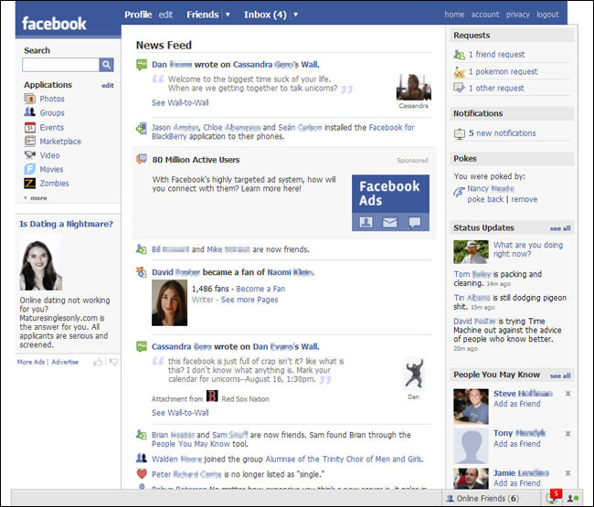
Facebook
Notes:
Are you on Facebook? Chances are good that you, your friends, your co-workers, your neighbors, and many others are. Facebook is best known as a place for musing with friends, vacation pictures, links to fun videos, poking, and many other things that have nothing to do with job hunting. Its casual and used mostly just for fun but can also help you with your job search.

Slide 14
Using Facebook for Business Networking
Keep your Facebook profile appropriate and check privacy settings.
Connect with friends and people of similar interests.
Add a professional profile picture.
Add jobs, education, and activities related to career
Notes:
It is important to have a secure professional account separate from your personal account. Companies can use Facebook to screen job candidates. If you are planning on using Facebook in search of jobs your profile needs to reflect this. Think of your Facebook page as a bill board that shows you as a person but also shows why you would be a great catch for an employer.
Facilitator: Pass out the Facebook Handout.

Slide 15






Which of these Tina Fey photos are appropriate for a professional profile photo?
Notes:
Let’s talk about profile pictures.
Facilitator: Ask participants which of these pictures of Tina Fey would be appropriate profile photos and why.
On most sites, your profile picture is public or at least visible to many people. Make it a good one, especially if you are seeking employment or just work at all. Most media sites will have a “help” feature that will tell you how to upload a picture to your profile. The best pictures to use are head shots, not showing your entire body and should be of just you with no other people, pets, etc. The background should be plain and your dress should be professional.

Slide 16
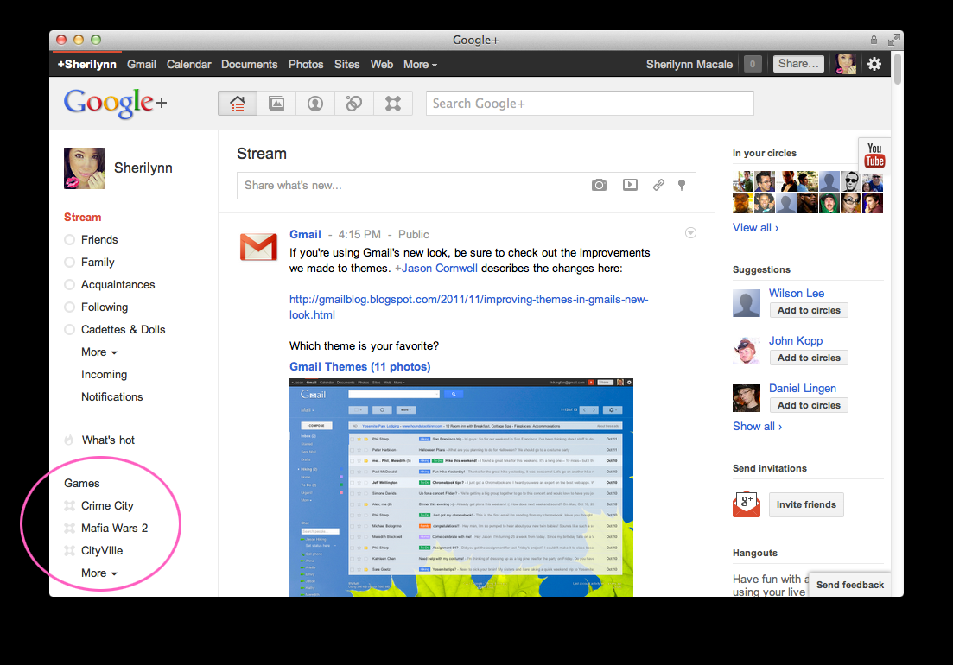
Notes:
Launched in 2011, Google + is the new kid on the block in social media. Friends are organized into “circles”. You can have a circle for your professional friends, a circle for family members, a circle for members of your club or team, etc. With other sites you amass friends and then organize them. With Google + you do it from the start. Another difference is that you can follow people whether they have agreed or not. Your profile includes an introduction, bragging rights section, occupation, employment, education, places lived, links to other profiles, and “contributor to” hyperlinks. Be sure to make your profile stand out and look professional.

Slide 17
Google+
Depends on industry and location
IT, media, marketing, arts, etc.
Big cities; other countries
If you decide to sign up
  Your name and tagline are public
  Everything else can be made private
  Follow same guidelines as other sites
  Join communities that share interests
Notes:
In our labor market area job hunting with Google + may or may not be effective. But Google owns the number 1 and 2 search engines in the world (Google and YouTube) which allows you to reach a wide audience with your posts, so that may be a reason enough to check into it and try it out.
Facilitator: Pass out the Google+ Handout

Slide 18

LinkedIn – A job seeker’s best friend
Candidates use profiles to make themselves stand out
Search companies and open positions
Focuses on education, experience, skills, etc.
Connect with professionals, recruiters, and other job seekers
Notes:
If you have a job or are looking for a job, you should be on LinkedIn. It’s the professional networking site. If you only want to use one social media for job search then this is the one to choose.

Slide 19
On LinkedIn you can …….
Market and promote yourself
Gain access to top experts
Do unique company research
Maintain an online Rolodex
Find professional peers
Locate job postings
Notes:
What can you do on LinkedIn? You need to become a member to actually get all the benefits of the program.

Slide 20
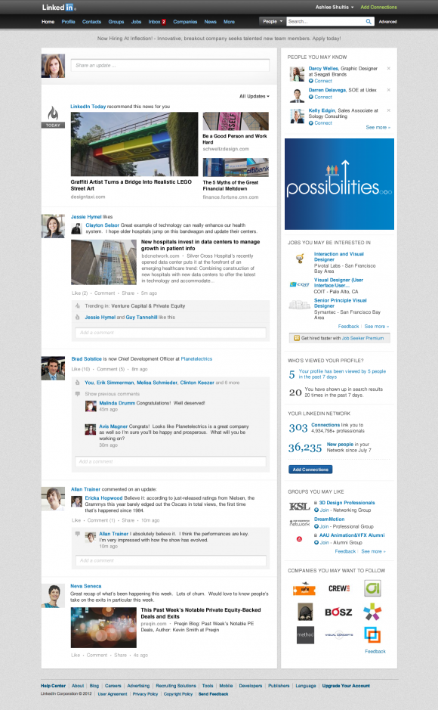
Notes:
Once you have created a profile and connected with some people, your homepage will look something like this. The page gives news items of interest to you, lets you follow comments on your news feed, recommends others to communicate with, suggests jobs and companies you may be interested in and tracks your profile activity. Using the tool bar at the top you can connect with all the main public areas of LinkedIn such as Groups which allows you to network with others in your field, Jobs which acts as a pathway to millions of job possibilities, Companies which lets you keep your eye on companies you may be interested in, News of what’s happening and much more.

Slide 21
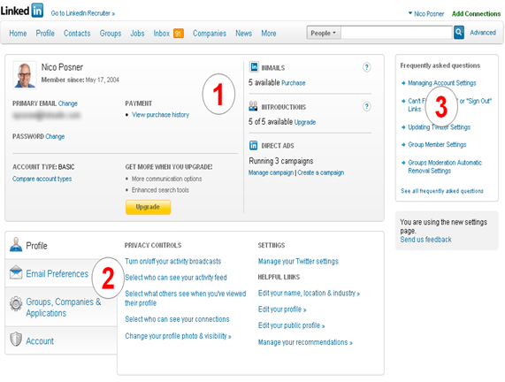
Notes:
This is the settings screen. From this screen you can update your profile, complete your privacy settings, view email preferences, and much more. Section 1 shows your basic profile information and the ability for you to upgrade. Section 2 shows your privacy controls, edit settings, and links. Section 3 offers you assistance in the form of FAQ’s.

Slide 22
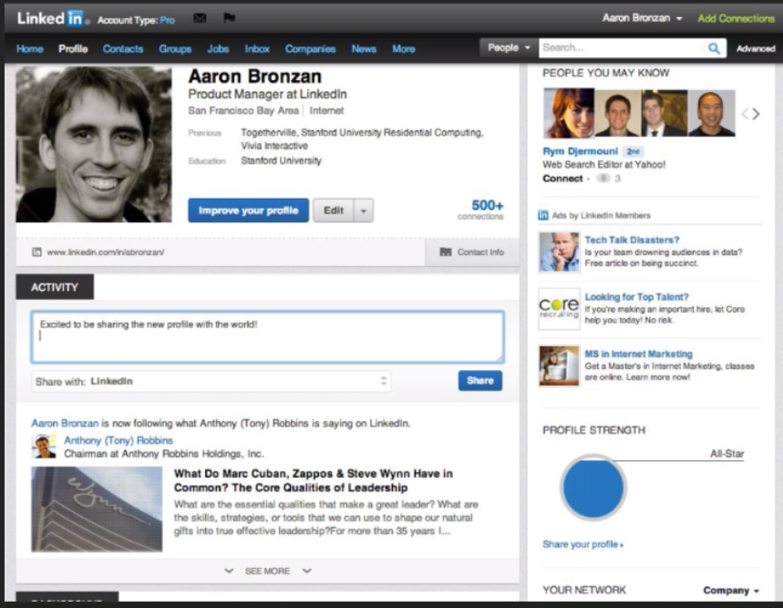
LinkedIn Profile Screen
Notes:
Your profile page should show a professional headshot. The headline should read like a newspaper headline and be attention getting. Experiences should be complete and be rich in keywords. By including keywords that people are using to find someone like you, you are ensuring that your profile performs well in searches and that you will be found. To truly leverage LinkedIn its important to have a strong customized network with many connections. Your Summary needs to POP! Do not copy and paste your resume. Your summary should be engaging and impressive to your reader and so much more than just a professional history. Once the reader has finished your summary, tell them how to reach you. Have a clear call to action. You can also add sections to your profile for certifications, courses, organizations, etc..

Slide 23
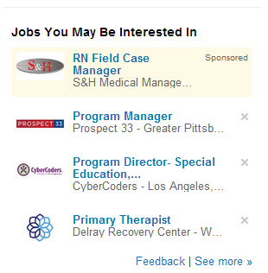
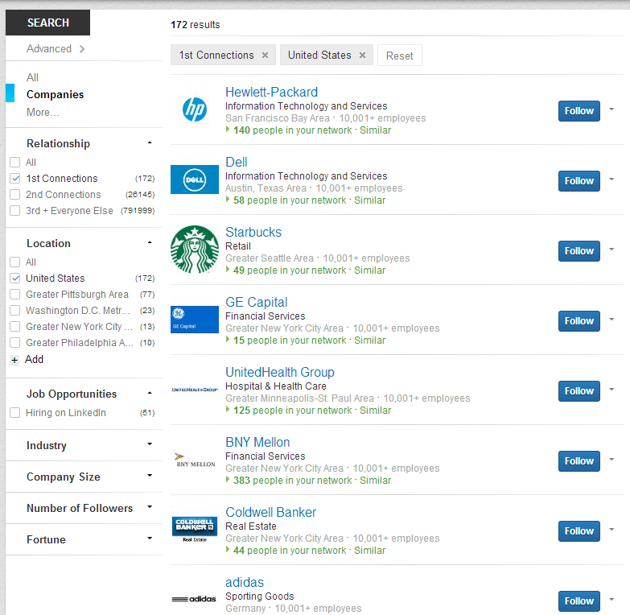
You get job suggestions based on your profile.
You can search and follow
companies.
Notes:
Who’s hiring? Who do you know? What jobs fit you?

Slide 24
How to be Linked in 10 immediate tips
Add a professional photo
Join about 45 relevant groups
Post discussions in groups
Participate in threads
Be an open networker
Get endorsements
Accept everyone, but invite strategically
Diversify your contacts
9. Use your network
10. Update regularly
Notes:
Once you sign up…be sure to do these things.
Facilitator: Pass out the LinkedIn Handout.

Slide 25
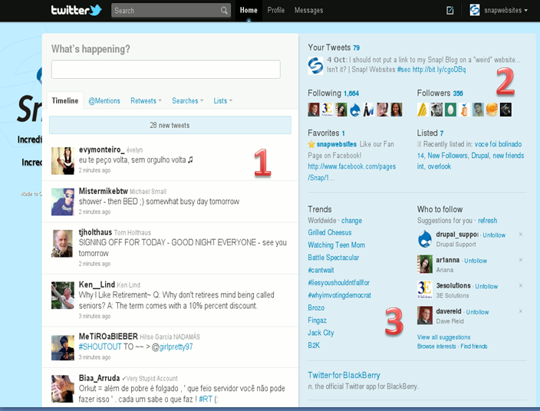
Notes:
Another social media site is Twitter. Twitter asks “What’s happening” which gives you the opportunity to showcase yourself using 140 characters or less. You can tweet (message) others and others can follow your tweets. Area 1 shows what the tweets of others will look like. You can quickly scroll thru the time wasters and focus on the tweets that can help you network and job search. Area 2 shows how many people you are following and how many are following you. Area 3 helps you to find people to follow and shows trends which are words or phrases being tweeted frequently.

Slide 26


Tweet your way to a job!
Connect with recruiters
Keep most of your tweets public
Employer focused profile summary
Link to LinkedIn page or online resume
Use professional photo
Be choosy with whom to follow
Notes:
These are some tips on using Twitter to assist you with your job search.
Facilitator: Pass out the Twitter Handout.

Slide 27
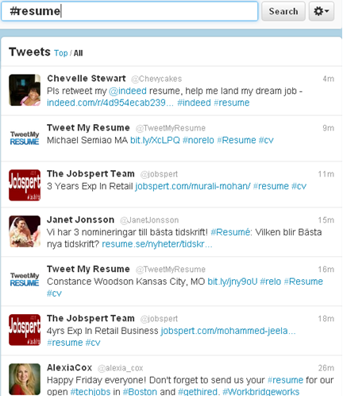
What the heck is a hashtag?
#healthcare
#trucking
#careercoach
#resume
#monroecountyjobs
Notes:
Hashtags aren’t just for Twitter anymore. They are for Facebook, Google, and many others. The hashtag or “pound” symbol in front of a word or phrase will help with a search of that topic.

Slide 28






Other sites
.com
.com
.com
Notes:
These sites don’t have millions of followers like Facebook or LinkedIN but they may also be helpful to you with your job search. Let’s look at them briefly one by one.

Slide 29

Tweet My Jobs
No Twitter account needed
Not all cities/industries
Build/save resume
Job alerts can be emailed, texted or tweeted right to you
Notes:
Some companies are connected to this and the site may get bigger as time goes on. You enter your job preference, the industry, and the geographic location. Job matches are then sent to your email account, smart phone, or Twitter account.

Slide 30

MEETUP
Find local groups to help with your career search
Takes you from online to face to face networking
Notes:
Good way to connect with people and network face to face. Join a group, attend an event, meet people. You can just Google Meetup and the name of a city to see if there are groups located near you or in your job search area. Smart phone app

Slide 31
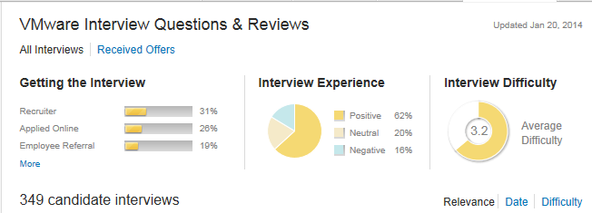
Glassdoor
Find salary, job titles, and interviewing questions for companies
Employees give reviews of companies
Applicants share interviewing questions/stories
Notes:
I call this the hidden gem because it gives inside tips about employers that can be used by job seekers. Want to know what type of questions a company asks during an interview? Glassdoor may have that information. Reviews from current/past employees? Yep those too. Smart phone app

Slide 32
Indeed
Pulls from other websites and links to them
With an account, you can
  Attach a resume
  Save jobs and searches
  Create job alerts
  Keep track of jobs applied
  Get recommendations of jobs
Notes:
Indeed has a proven track record. The best feature of this website is its ability to consolidate information from different websites and provide links to a variety of sites. You can keep track of your job search and have your resume on hand if you are not at your own computer!

Slide 33
Indiana Career Connect
Build a Resume
Search for Jobs
Apply for Jobs
Virtual Recruiter
Notes:
Indiana Career Connect, or ICC, is the State of Indiana’s job search website. Like Indeed it offers multiple job search tools and “spiders out” to obtain information from other websites. Hands down…one of the best websites to look for jobs.

Slide 34
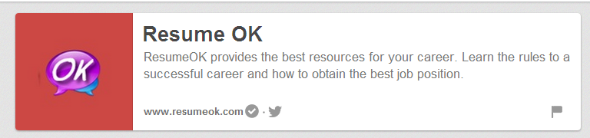
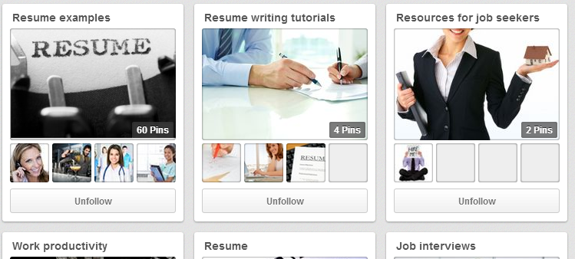
Pinterest
Follow boards for job search help and advice
Boards hold pins that keep track of websites, pictures, etc.
Notes:
Pinterest is like a bulletin board. Keeps things in order, same place. Just type in a search topic and related “pins” will show up.
Smart phone app

Slide 35
What about Monster, Careerbuilder, etc.?
Use to scope out jobs
  Find a job you like, go to employers website or check for another delivery method
Get career advice, quizzes, etc.
Do not recommend creating account
Too much spam
Contacted for jobs you have no experience in
Notes:
If you do decide to create an account beware of ”ads”. Its best to skip them unless you want a thousand emails or phone calls.

Slide 36












?
?
?
?
?
?
?
?
?
?
?
?
Notes:
I hope this has answered some of your social media questions and that you feel motivated to get online and use this technology to assist you in your job search.

Slide 37
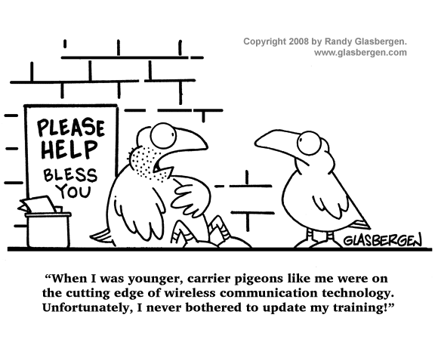
Pigeon Principle
Notes:
Technology is always changing so you do have to remain active with social media to keep up with those changes and the “latest and greatest” sites to access.

Slide 38
Websites:
www.facebook.com
www.twitter.com
www.pinterest.com
www.plus.google.com
www.glassdoor.com
www.indianacareerconnect.com
www.monster.com
www.linkedin.com
www.tweetmyjob.com
www.meetup.com
www.indeed.com

Slide 39
References
Social Media 2013. http://blog.digitalinsights.in/wp-content/uploads/2013/09/social-media-2013.jpg
“10 Things to Immediately do on LinkedIn” by John Heckers. Retrieved from www.careerealism.com on 5/31/2011
“How to Improve Your Job Search Through Social Media” www.socialmediatoday.com
“Using Twitter for Job Search” by Louise Fletcher. Retrieved from www.careerealism.com.
“Getting Started on Twitter: 25 Tips for Job-Seekers to Take Advantage of the Web’s Best-Kept Job Search Secret” by Susan Whitcomb. Retrieved from www.quintcareers.com.
“How to: Facebook” Module 3: Providing Career Development Services Using Technology Resources, VCED curriculum, GII
“How to Find a Job on LinkedIn Facebook Twitter Google+” by Brad Schepp and Debra Schepp

